Slide 1

MancheSTAR Fusion Society Lectures
Lecture 1: Introduction
MancheSTAR fusion Lecture series: Oscar van Huet Lindeman 2026/7
Adapted from previous material created by Tom Hughes and Charlotte Brown 2025/6

Slide 2
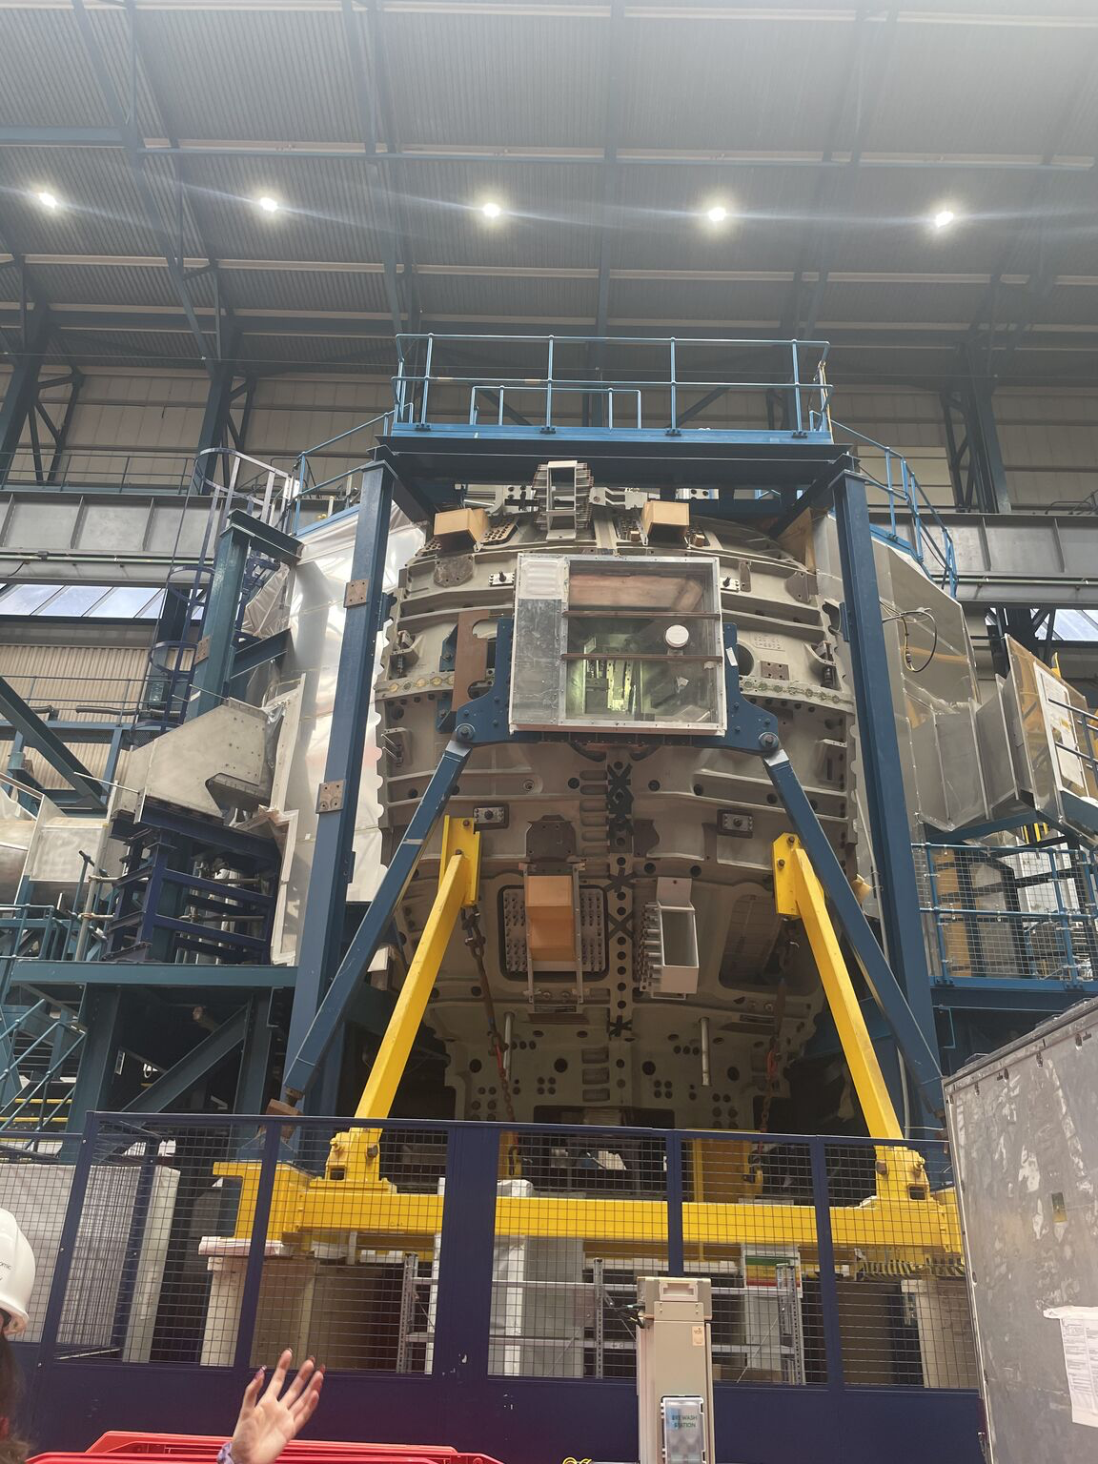
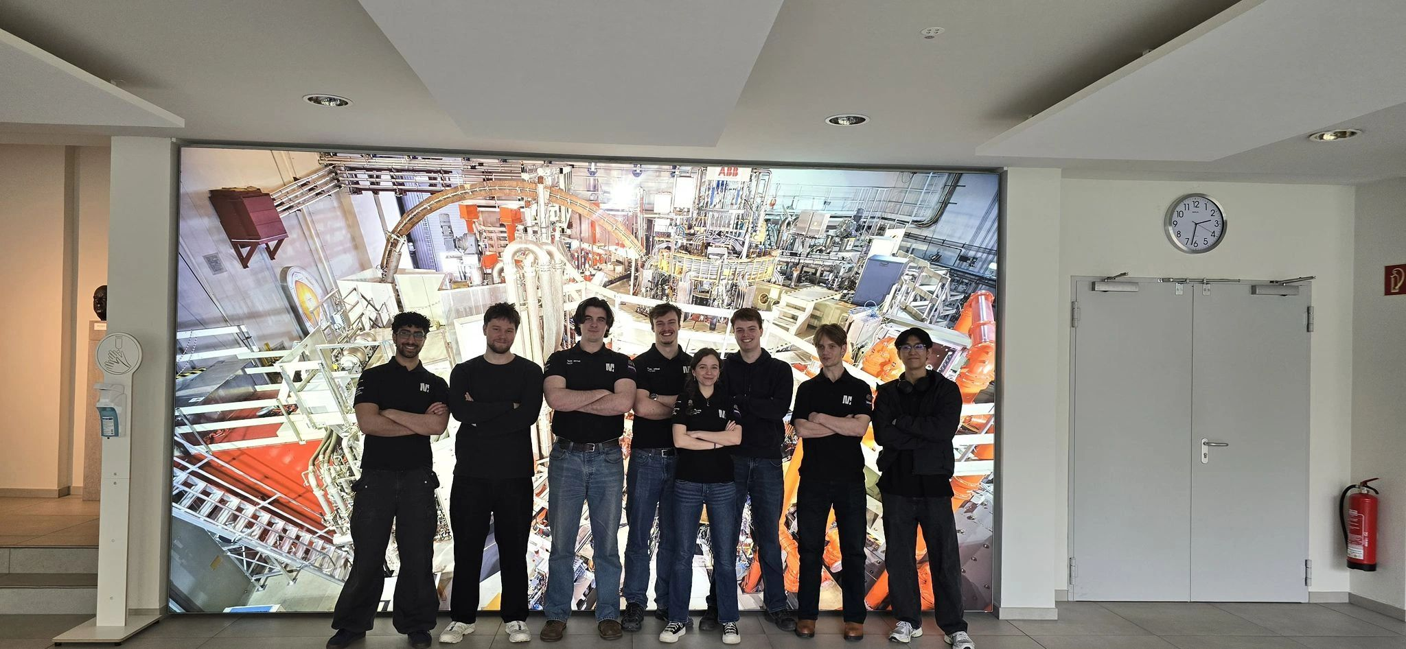
Who am I?
Oscar van Huet Lindeman
3rd Year Physics (Mphys) Student
Member of the Fusion Society Committee
Interested in Plasma Physics and Diagnostics

Slide 3
Disclaimer
Fallible! – Feel free to point out any mistakes I make
Questions! – Feel free to ask at any time
This is NOT a university course, No credits available sadly
Well done for coming to extra lectures

Slide 4
Aim of the Lecture Series
“To give enough understanding to a complete fusion novice to be able to then conduct their own research into a field that they are interested in within Nuclear Fusion.”

Slide 5
Current Plan
Introduction
Plasma Physics
Reactor Design: Tokamak
Reactor Design: Other
Diagnostics
Tritium Breeding
This is open to change, discussion…

Slide 6
External/Other speakers
Other members of the Society
External Speakers
Announced as and When

Slide 7
Enough about me…
First/second/third years…?
Postgrads…?
How many of you have heard about Nuclear Fusion?

Slide 8

Let's start at the beginning
Nuclear Fusion: in fusion one starts with light elements and brings them together so that they may fuse to form heavier elements. The resulting heavier elements have slightly less mass than the fusing elements and this mass difference results in the release of energy.[1]
Einstein’s mass energy Relation:
$$E=mc^{2}$$
Binding energy: The energy required to completely disassemble a nucleus into its constituent protons and neutrons at rest or to separate them to an infinite distance.

Slide 9

Quick Calculation
Mass of Deuteron ($H^{2}$) = 2.01355 u
Mass of Proton ($m_{p}$)= 1.00728 u
Mass of Neutron ($m_{n}$)= 1.00866 u
1u = 931.494 MeV/c² = 1.660539$x{10}^{−27}$kg
$m_{p}+m_{n}=$2.01594 u
$Δm$ = 2.01594 u - 2.01355 u = 0.00239 u
(Let’s convert using: $E=mc^{2}$)
$E$ = 0.00239 x 931.494 MeV/c² x c² = 2.22627 MeV
There’s a difference!
All values were taken from the NIST website: https://www.nist.gov/

Slide 10
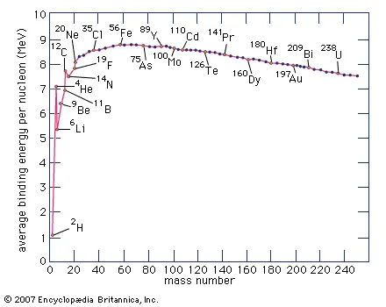
Binding Energy against Nucleon
Image credit: Britannica Encyclopedia 2007, https://www.britannica.com/science/nuclear-binding-energy, accessed: 10/09/2026

Slide 11

Electrostatic Repulsion!
Coulomb Repulsion: $V_{C}= \frac{Z_{1}Z_{2}e^{2}}{4πε_{0}r}$ [2] Potential Energy Barrier to fusion.
For fusion to Occur ~ 10⁻¹⁵ m or (1 fm)
D-T fusion : ~ 0.4 MeV
Temperatures of 10⁷-10⁹ K !!!

Slide 12
Confinement
Any suggestions?

Slide 13
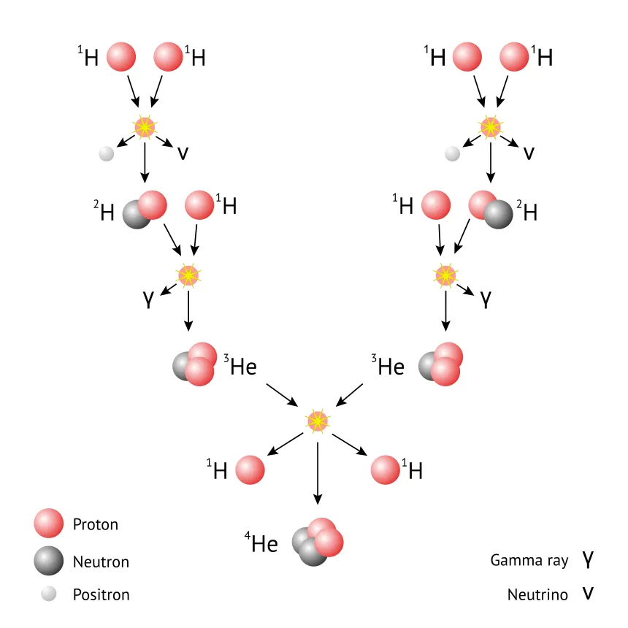
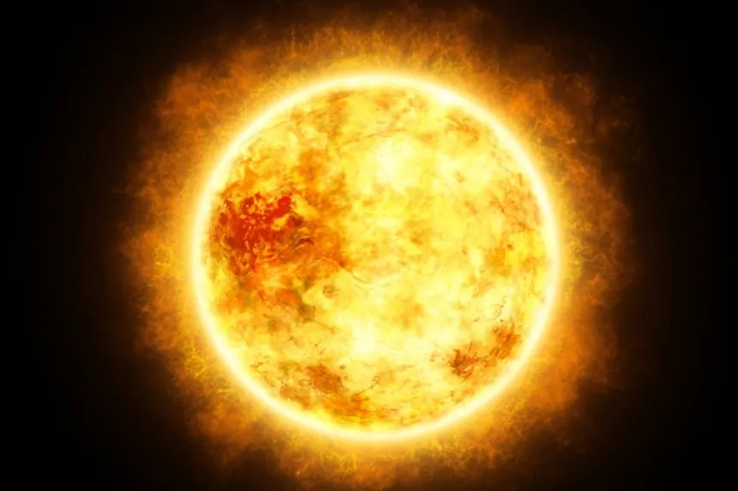
The Sun
Classic example of Fusion.
Gravitationally confines the particles
Delicate balance of Gravity and Fusion pressure
PP chain
We owe our existence to Fusion!
Image credit (top): Energy Encyclopedia, https://www.energyencyclopedia.com/en/glossary/proton-proton-chain-p-p-chain, accessed: 10/09/2026
Image credit (bottom): The New Scientist, https://www.newscientist.com/article/2457069-see-the-sun-revealed-in-stunning-glory-by-solar-orbiter-pictures/, accessed: 10/09/2026

Slide 14
I have a Confession…
Super hot gas → plasma
Separation of Charges due to disassociation of the electrons
13.6 eV energy to emit an electron from Hydrogen Fusion is of the order MeV!
Plasmas respond to electromagnetic forces → MAGNETS!

Slide 15
The recipe
PP Chain? D-T?
Cross section: “A measure of the effective area presented by a target nucleus to an incident particle for a specific reaction”
Generally, increases with the amount of energy for fusion

Slide 16
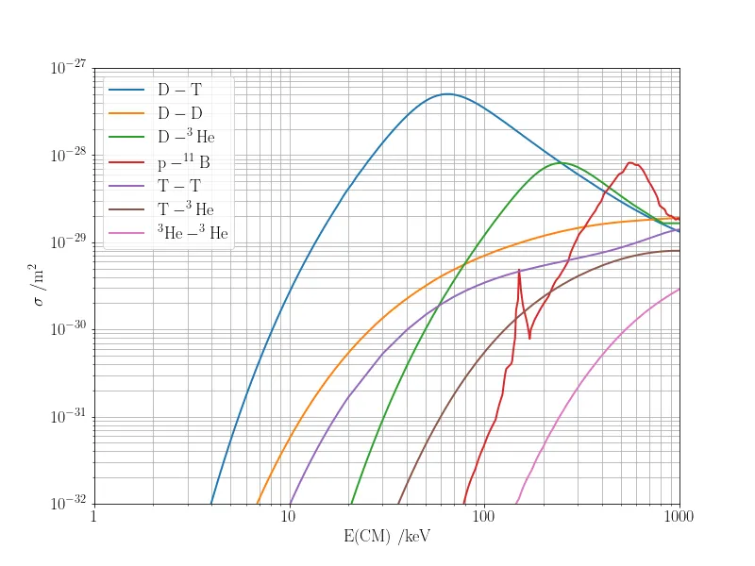
Cross section against Energy
Deuterium – Tritium Reaction is most achievable for the lowest energy
Image credit: scipython, https://scipython.com/blog/nuclear-fusion-cross-sections/, accessed: 10/09/2026

Slide 17
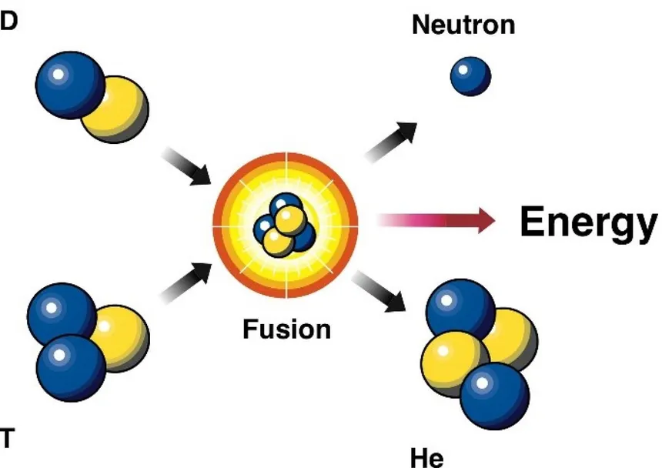
The D-T reaction
14.1 MeV Neutron [1]
3.5 MeV Helium Ion [1]
Deuterium is very abundant (1/6000)
Tritium is not
Image credit: Department of Energy, https://www.energy.gov/science/doe-explainsfusion-reactions, accessed: 10/09/2026

Slide 18
Hurdles
Incredibly high Temperatures
Magnet development
Neutrons!
Control and maintenance
Not fully developed
Scarcity of Fuel
Public perception
So So Many more…

Slide 19
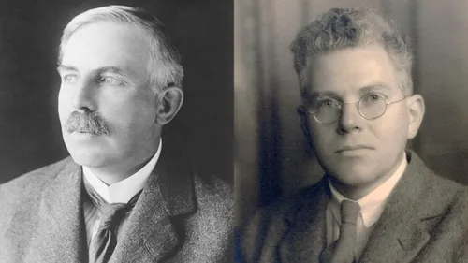
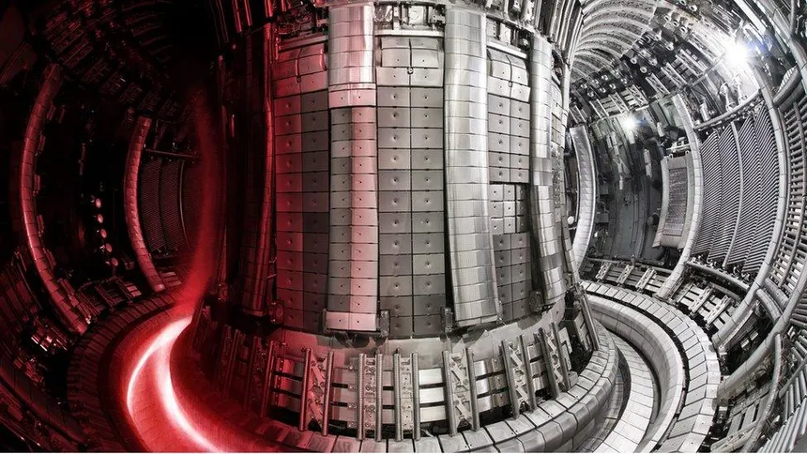
A brief History of Fusion (For Power)
1932: Rutherford and Oliphant
1950’s: Tokamak and Stellarator
1970’s: JET (Joint European Torus) begins
1980’s: ITER begins
1990’s: First JET tests

Slide 20
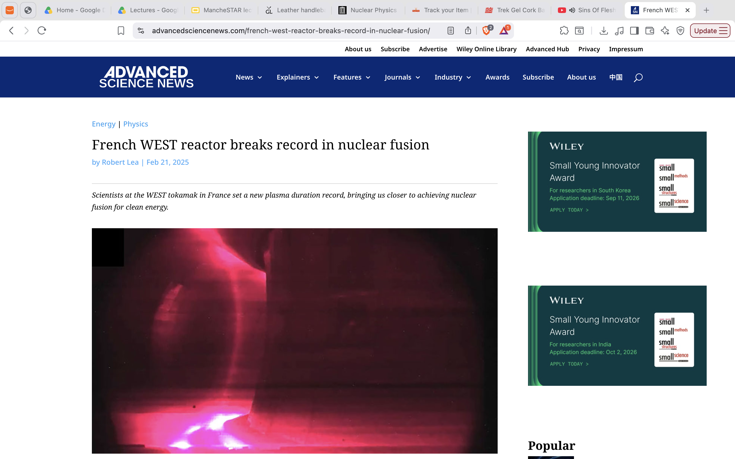
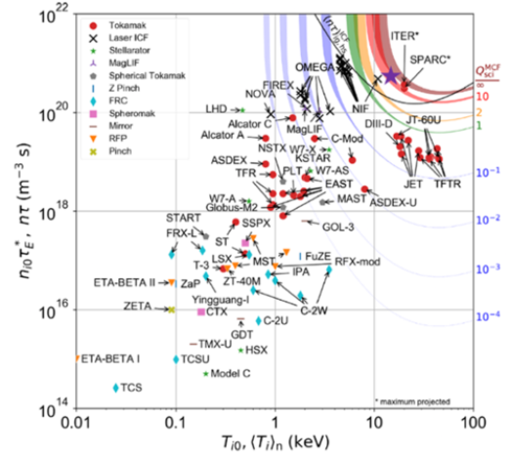
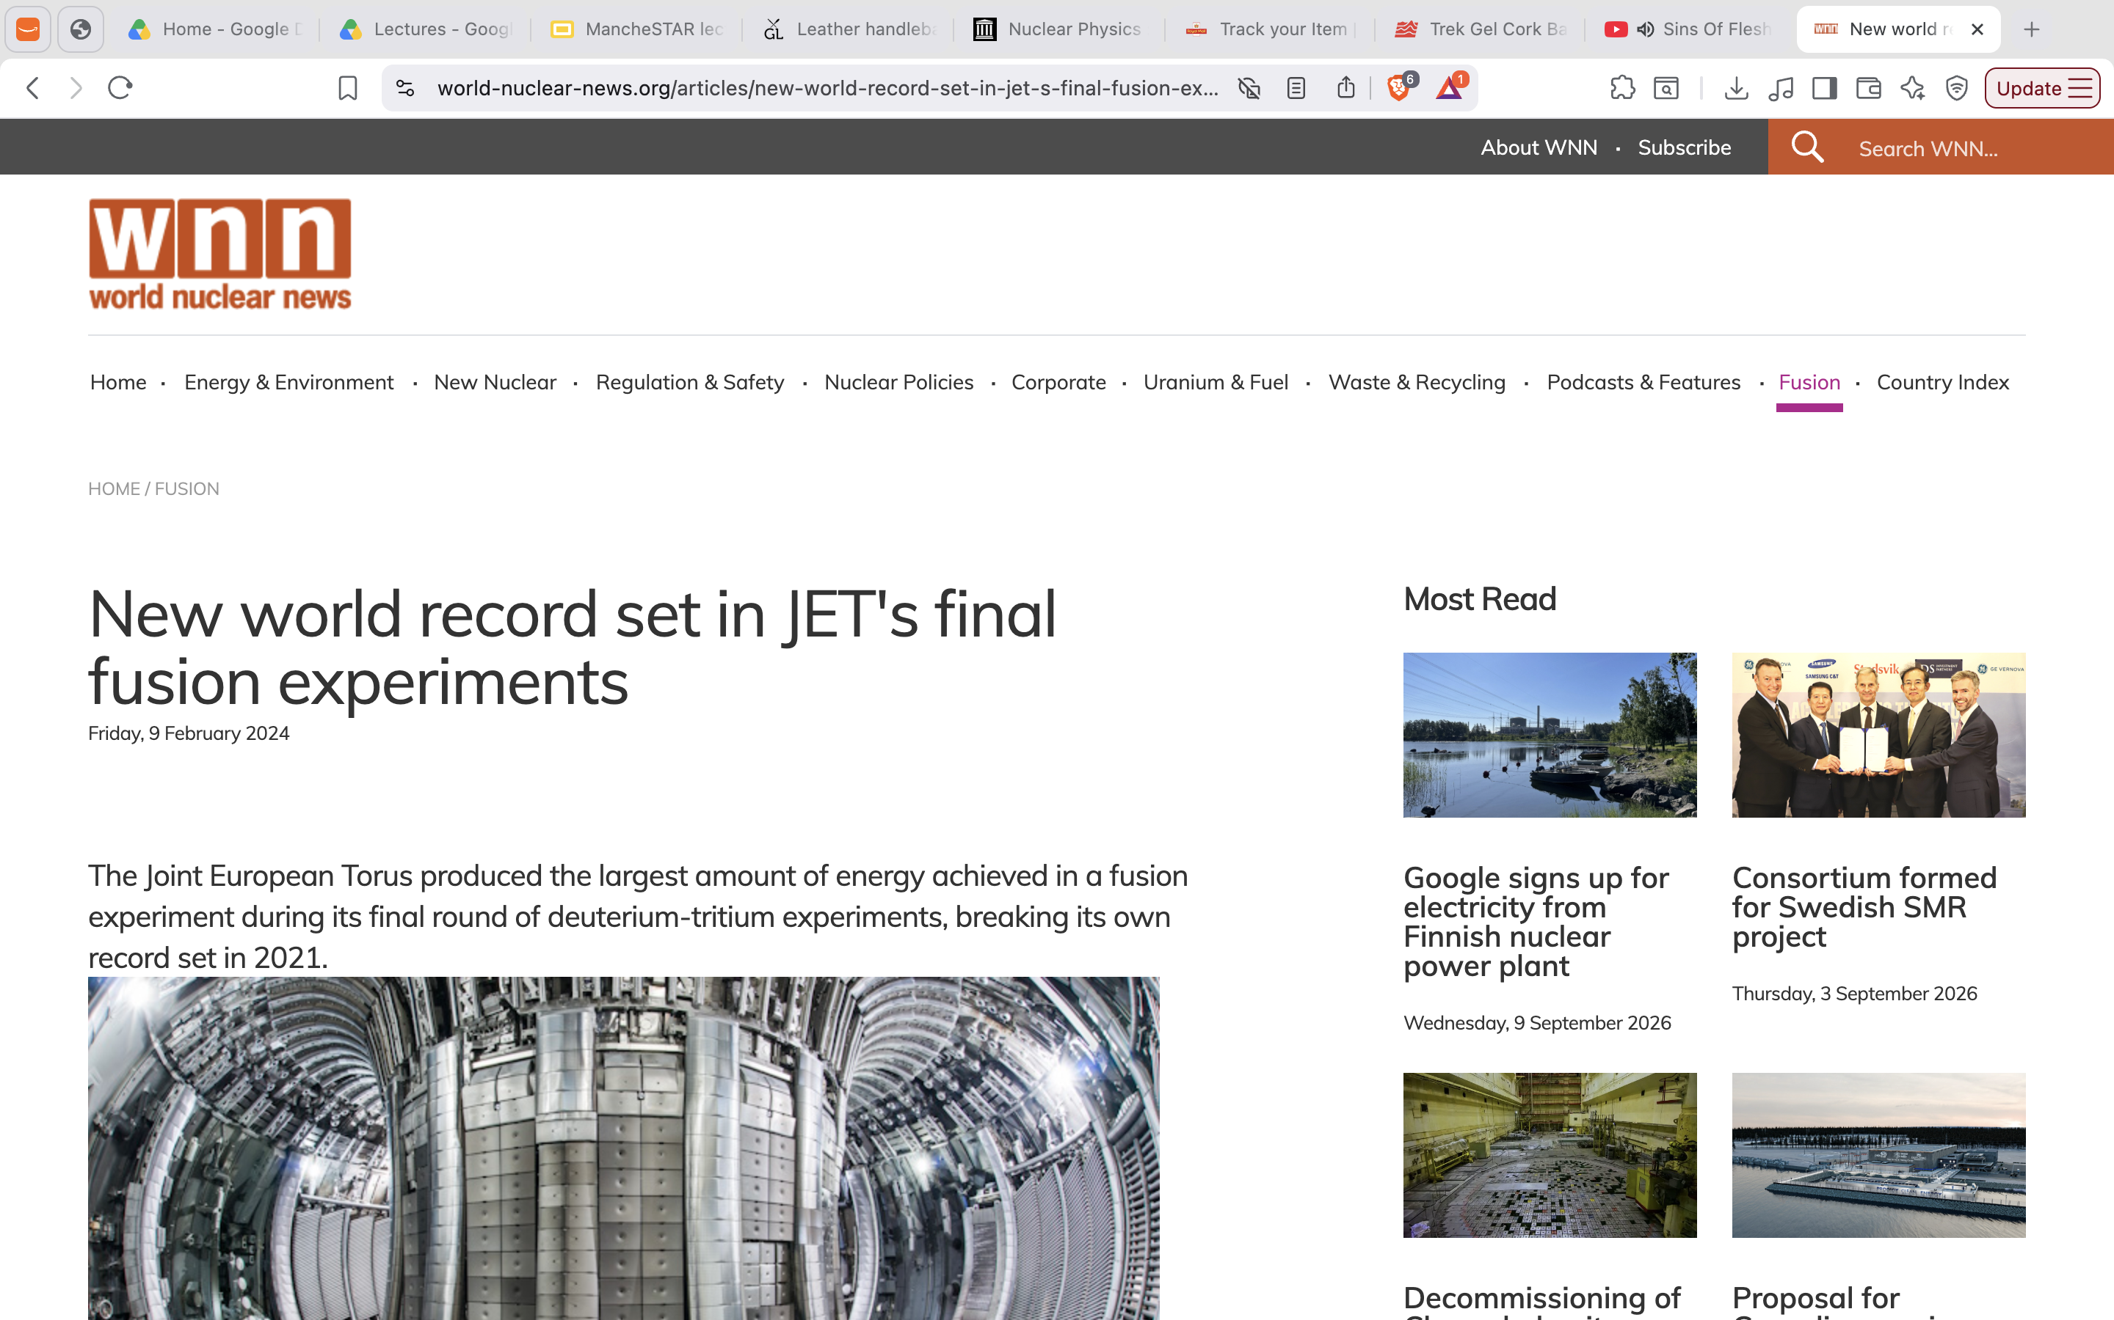
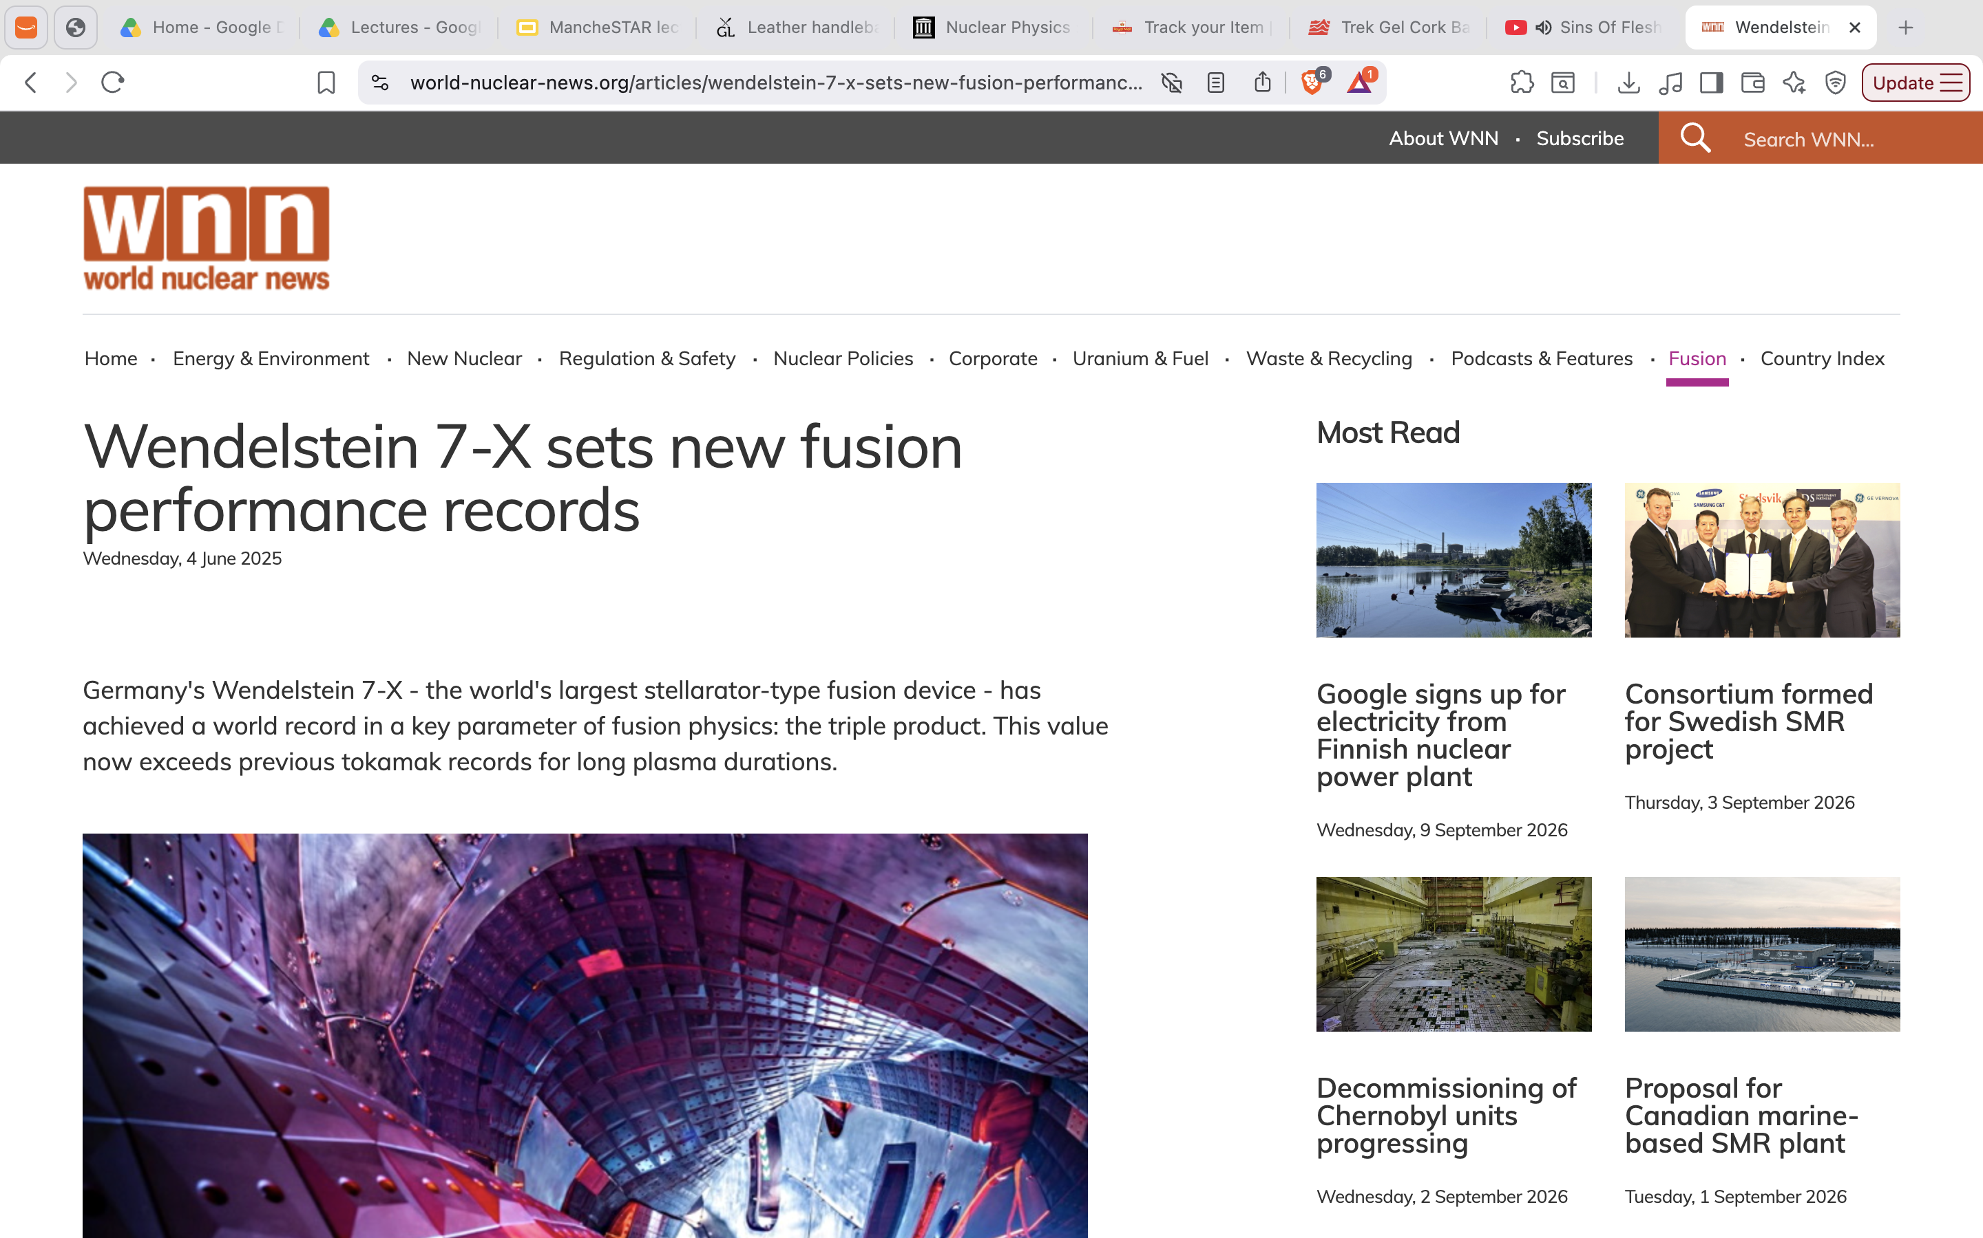
Current Fusion Power Plants

Slide 21
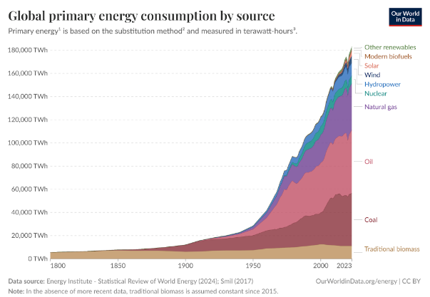
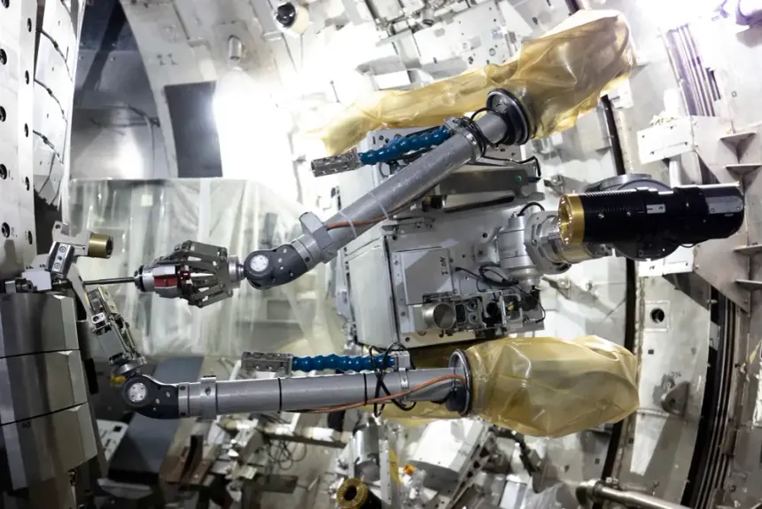
But why?
Rapidly increasing demand for renewables
Geopolitical equality: (only need access to Seawater)
Innovation in technology: HTS magnets, Robotics

Slide 22
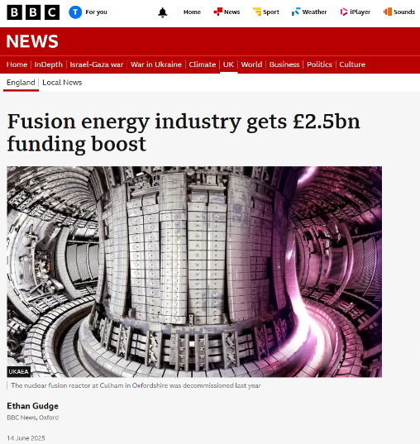
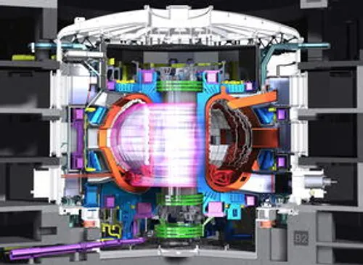
What’s Next?
ARC→SPARC privately owned company intending to achieve Q>1!
STEP→The UK’s own project to build a fully functioning powerplant!
ITER → building is 85% complete! [3]

Slide 23

Questions?

Slide 24
Recap of current course plan
Introduction
Plasma Physics
Reactor Design: Tokamak
Reactor Design: Other
Diagnostics
Tritium Breeding
Let me know if there are any changes or additions you would like to make.

Slide 25
MancheSTAR
Jet Trip
Fusion Careers Workshop
Engineering Academy
Women in Fusion

Slide 26
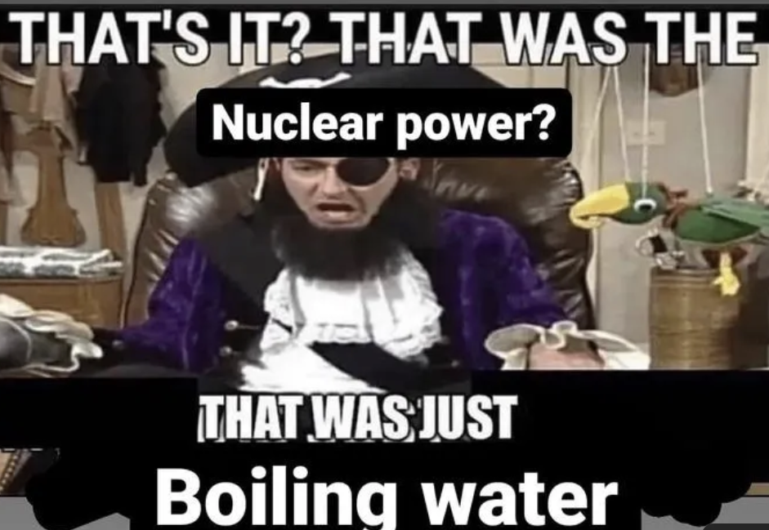
Thank you For Listening!

Slide 27
References
[1] IAEA, M. Kikuchi, K. Lackner, M.Q. Tran, Fusion Physics, Vienna, 2012
[2] B.R.Martin, G. Shaw, Nuclear and Particle Physics, Wiley, 3rd edition, 2019
[3] ITER website, accessed, 11/09/2026, https://www.iter.org/node/20687/building-works-required-first-plasma-are-85-complete

