Slide 1

Lecture 2: Plasma Physics
MancheSTAR nuclear fusion lecture series
Charlotte Brown 2025

Slide 2
What is a ‘plasma’?

Slide 3
Learning objectives
By the end of this lecture, you should be able to:
Recall the defining features of a plasma
Describe the motion of charged particles in electromagnetic fields
Apply knowledge of particle drifts to discuss confinement techniques

Slide 4
Defining features of a plasma
There are 4 conditions that must be met before an ionised gas is considered a plasma
A plasma:
Satisfies quasi-neutrality
Able to shield an applied electric field
Must behave like a fluid as described by magnetohydrodynamics (MHD)
Must be a large number of particles in the shielded region (Debye sphere)

Slide 5
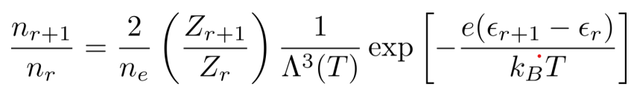
Ionisation
A plasma does not have to be completely ionised
There must be enough charged particles so that the other plasma conditions can be met
Ionisation is dependent on temperature (Saha-Langmuir equation)
Number density of r-th ionisation state
De Broglie wavelength for thermal electrons
Ionisation energy of r-th ionisation state

Slide 6
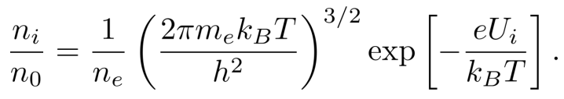
Ionisation
As hydrogen only has one ionisation state, the maths becomes a bit nicer!

Slide 7
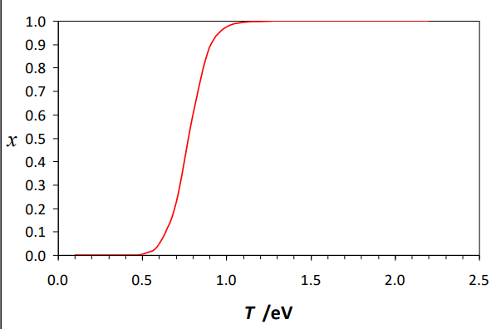



For a typical fusion plasma n_{e} ≈ 10²⁰m⁻³:
From Dr Koki Imada’s 2023 Fusion CDT lecture series
Aside:
E ≈ k_{B}T for a gas/plasma
Plasma physicists use eV instead of K
Essentially all atoms are ionised
Fusion plasma is typically 10 keV
1.5 eV ≈ 15 000 K

Slide 8
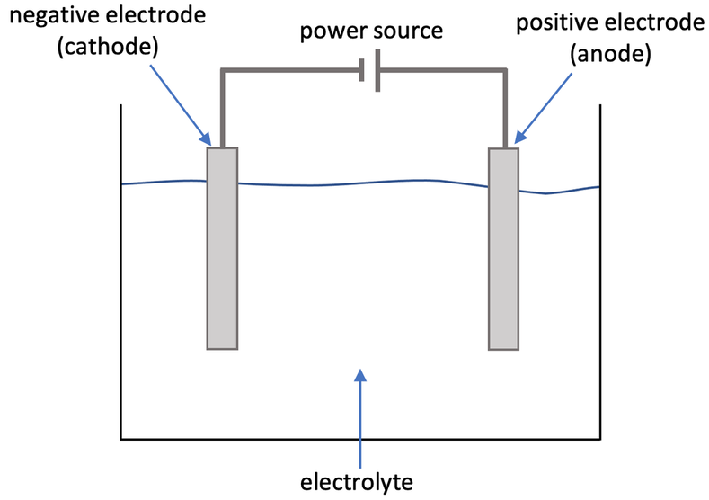


Debye Shielding
When applying an external electric field, the ions are attracted to the opposite charge
The build up of charges cancels out the external field by creating an opposing electric field
Plasma

Slide 9
Debye Shielding
External E field
When applying an external electric field, the ions are attracted to the opposite charge
The build up of charges cancels out the external field by creating an opposing electric field
Induced E field
Plasma

Slide 10
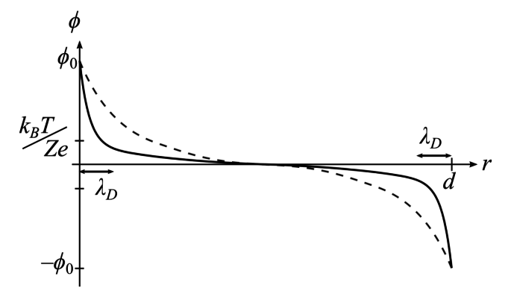

Debye Shielding
Debye shielding is not perfect!
Ions have thermal energy which can overcome the electric potential
This means the layer of shielding ions has finite thickness – the Debye length
From Dr Koki Imada’s 2023 Fusion CDT lecture series
The length scale of a plasma must be much bigger than the Debye length
This maintains quasi-neutrality in the bulk plasma – a defining feature of plasmas!

Slide 11
Charged particles in EM fields

Slide 12


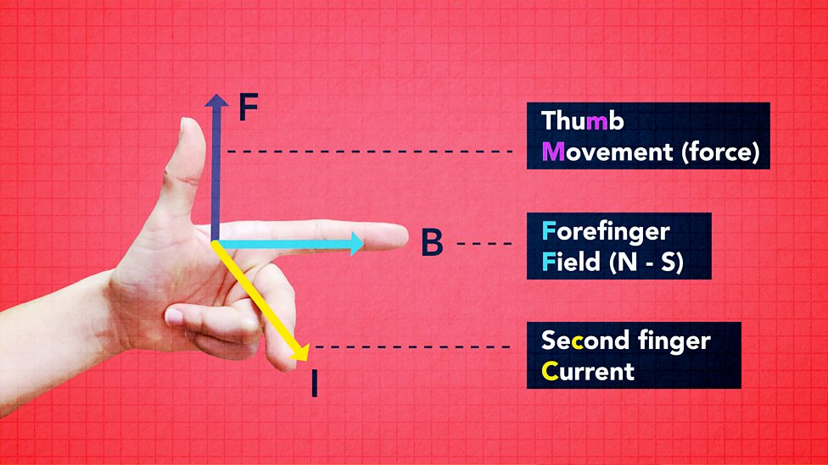
Electric and Magnetic Forces
The electric force acts along field lines
The magnetic force acts perpendicular to field lines
Current = direction positive charge is travelling
BBC Bitesize GCSE Physics

Slide 13
Quick Quiz!

Slide 14
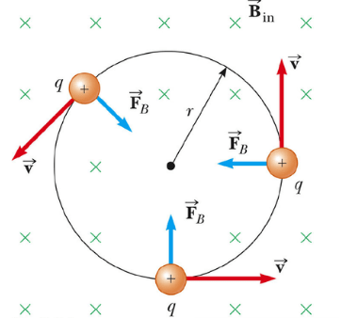

Charged particles in uniform fields
Particles travelling perpendicular to a B field travel in circles around field lines
The frequency of oscillation (gyrofrequency/Larmor frequency/cyclotron frequency)

Slide 15
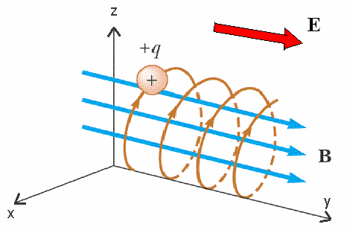

Charged particles in uniform fields
If we introduce an electric field perpendicular to the B field, helical motion is induced
The guiding centre of the oscillation ‘drifts’
This is known as E x B drift
Irawan et al. (2014)

Slide 16

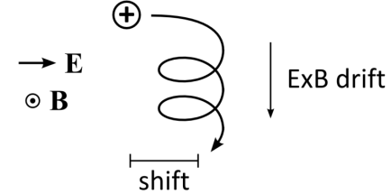
What if the E-field is time dependent?
E
If I apply an E field the ion starts accelerating
As the ion’s velocity increases it begins to experience magnetic force
It starts to gyrate and E x B drift occurs
Note it has shifted slightly in the x direction

Slide 17
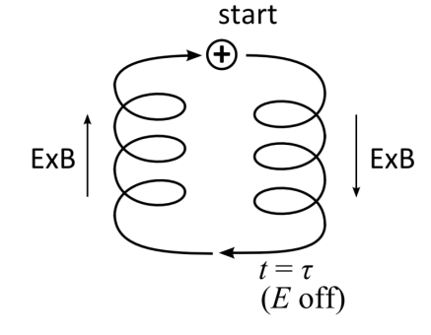
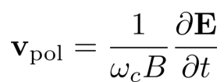
What if the E-field is time dependent?
If I turn the field off and then reverse the direction of the field, the direction of the drift is reversed
This is known as polarisation drift
Note it is dependent on mass (through gyrofrequency) so ions have a much greater velocity than electrons

Slide 18
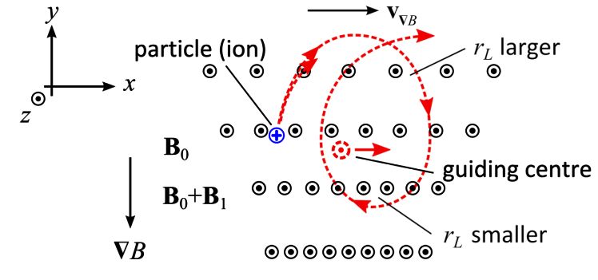
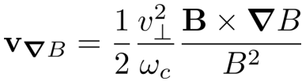
Inhomogenous B fields
Let’s ignore E fields for a minute
If the magnetic field varies in space the radius of the oscillation also varies
The change in radius leads to a drift in the guiding centre
This is ‘grad B’ drift

Slide 19
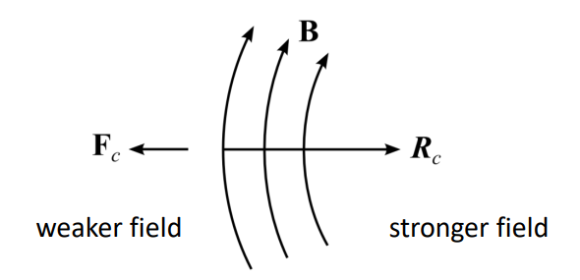
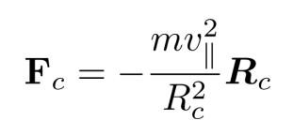
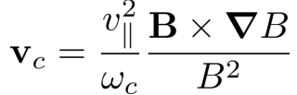
Inhomogenous B fields
The guiding centre of a particle follows the magnetic field line
If the field line is curved, the particle experiences centrifugal force (F_{c})
An external force causes the guiding centre to drift and so we get ‘curvature drift’

Slide 20
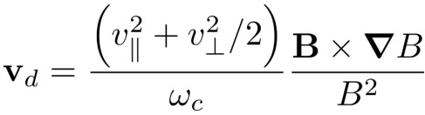
Magnetic Drift
It is common practice to combine ‘grad B’ and curvature drifts into ‘magnetic drift’
Magnetic drift:
is perpendicular to the magnetic field lines
depends only on the gradient of B perpendicular to the field lines
is charge-dependent - ions and electrons drift in opposite directions, leading to charge separation
not dependent on mass

Slide 21
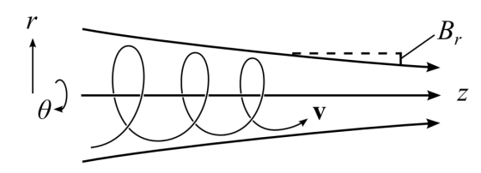
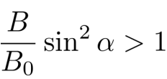
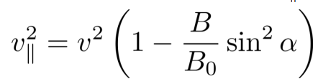



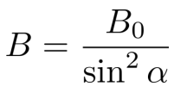
What happens if the gradient is parallel to the motion of the particle?
As the particle enters the stronger field it’s radius of oscillation decreases
What if:
is imaginary
This means the particle must be reflected when:

Slide 22

What happens if the gradient is parallel to the motion of the particle?
This means particles with too low a are trapped in the weaker field
This is known as the magnetic mirror effect
The magnetic mirror force is:

Slide 23
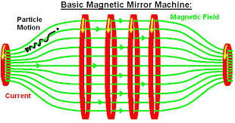
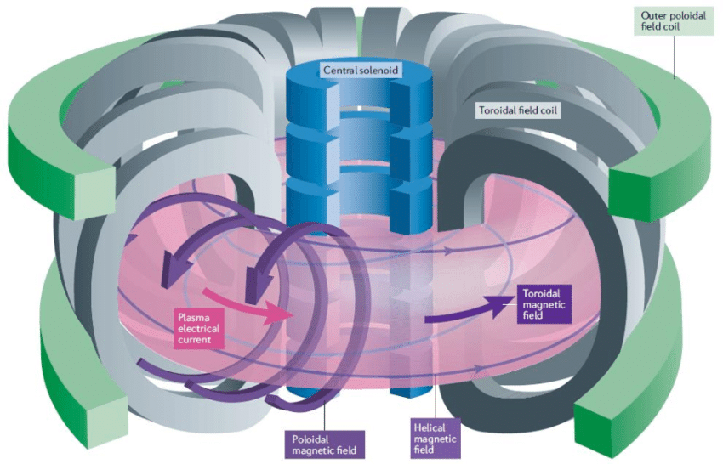
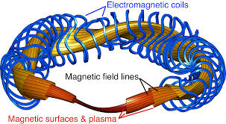
Why don’t we use magnetic mirrors for fusion?

Slide 24
Summary
Plasmas are defined by:
Satisfying quasi-neutrality
Shielding applied electric fields
Behaving like a fluid as described by magnetohydrodynamics (MHD)
Having a large number of particles in the shielded region (Debye sphere)
There are lots of different types of particle drift including:
E x B drift
Polarisation drift
Grad B drift
Curvature drift
Magnetic drift

Slide 25

Questions?
Please fill out the feedback form for this lecture – it helps us improve your experience!

Slide 26
Thank you for listening, any questions?
Please fill out the feedback form for today’s session:

